Slide 1
Towards the Automatic Quality Evaluation of RESTful APIs Using Design Rule Violations
Daniel Abajirov, Timothy Ernst, Manuel Merkel
Final presentation of MSc. research project

Slide 2



Manuel Merkel
Timothy Ernst
Daniel Abajirov

Slide 3
Content
Introduction
Verification & Validation
Conclusion & Outlook
Demo
Background
Project Management

Slide 4
Background
REST is an architectural style for developing loosely coupled applications that run over the network
The application programming interface (API) is a means of providing access to data and services.
What makes an API a REST API depends on how closely it adopts the ideas (or constraints) of Fielding´s dissertation
OpenAPI refers to a description of HTTP-based API. This comes usually in the form of a YAML or JSON file.

Slide 5
Introduction
Importance of REST APIs is increasing
Design rules for REST APIs by Massé [1]
Empirical study [2] provided evidence for the effectiveness of certain design rules
Goal of study
Tool-support for analyzing OpenAPI definitions
Analyze and select existing REST API design rules
Link rules with quality attributes
Evaluation of the CLI regarding robustness, effectiveness and performance
[1] MASSE, Mark. REST API design rulebook: designing consistent RESTful web service interfaces. " O'Reilly Media, Inc.", 2011.
[2] KOTSTEIN, Sebastian; BOGNER, Justus. Which RESTful API design rules are important and how do they improve software
quality? A Delphi study with industry experts.
In: Symposium and Summer School on Service-Oriented Computing. Springer, Cham, 2021. S. 154-173.

Slide 6

Management
Scrum-like agile development
Sprint length of two weeks
Weekly meetings on site
Project board of GitHub as sprint backlog
Prototyping

Slide 7

Use Case Demo

Slide 8
Verification & Validation
Unit Tests
Performance
Robustness
Effectiveness

Slide 9
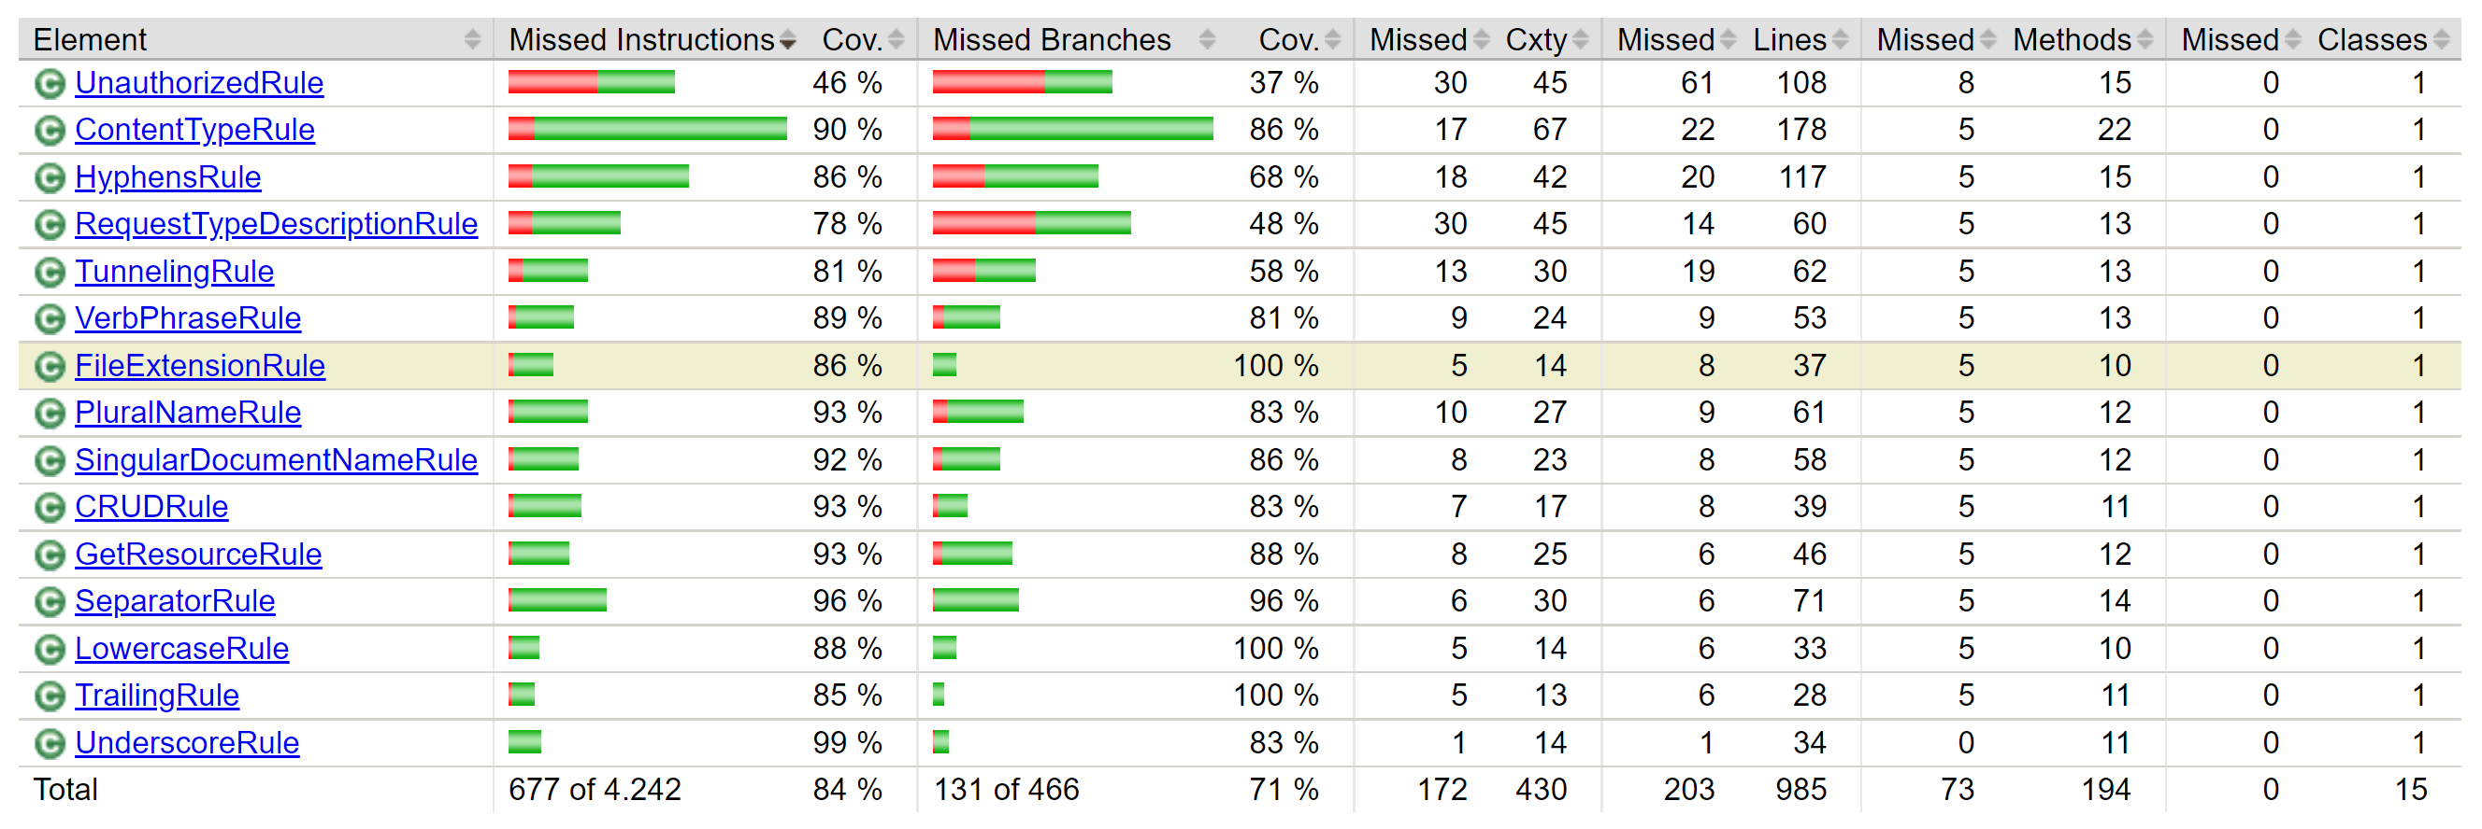
Unit Tests

Slide 10

Robustness
Exploratory analysis of 2,346 OpenAPI definitions from “apis.guru”
Python script to run tool with a list of OpenAPI definitions as input
Second python script to collect OpenAPI definitions missing a report file
Third python script to re-run failed OpenAPI definitions and collect error messages

Slide 11

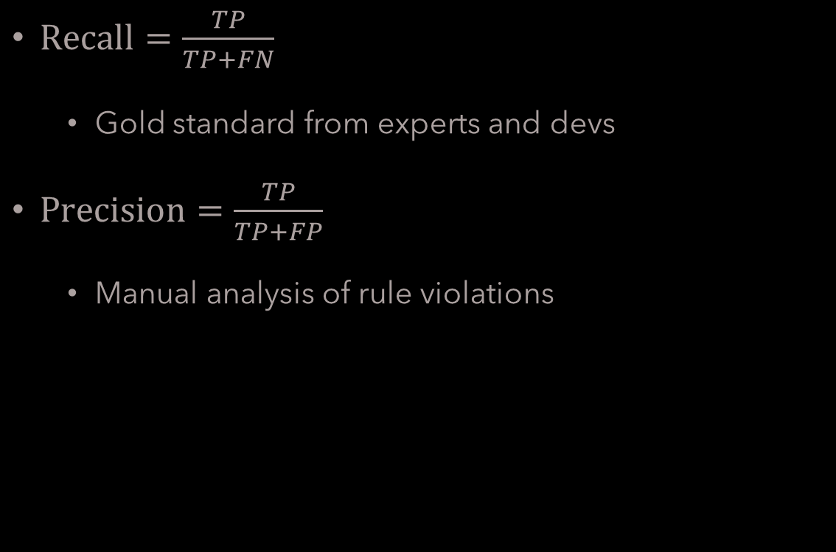
Effectiveness
True-positive (TP)
False-positive (FP)
False-negaive (FN)
$Recall=\frac{TP}{TP+FN}$
Gold standard from experts and devs
$Precision=\frac{TP}{TP+FP}$
Manual analysis of rule violations

Slide 12

Performance
Exploratory analysis of 2,331 OpenAPI definitions
Performance efficiency from ISO 25010
Resource utilization
Time behavior
Script to run the analysis and the measurements

Slide 13
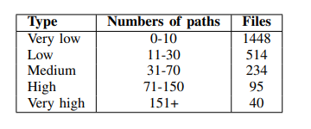
Performance
Python scripts for categorisation and analysis
Library used for the resource utilisation measurement
psutil [3]
[3] psutil https://pypi.org/project/psutil/

Slide 14
Robustness Results
Of 2346 OpenAPI definitions 2300 reports were generated
Success rate: 98.03%
46 Errors due to bugs, parsing errors or reaching RAM limit

Slide 15
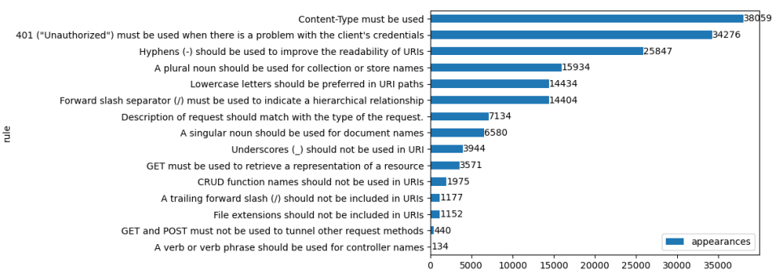
Robustness Results
Content-Type: 22.51% of total violations
"Unauthorized": 20.27% of total violations

Slide 16
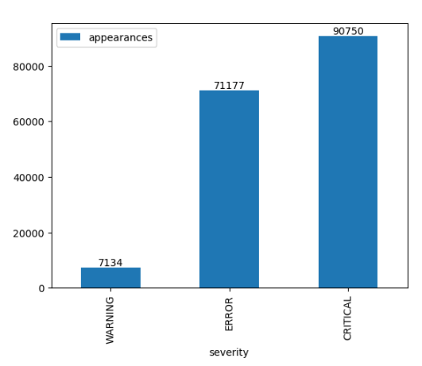
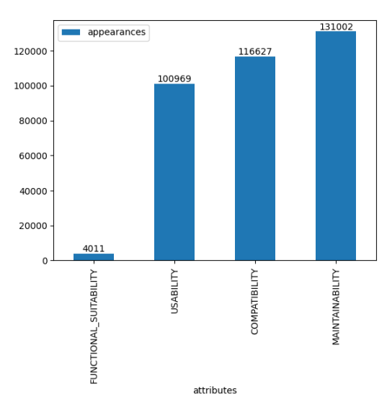
Robustness Results
53.68%
77.49%
68.99%
42.10%
59.72%
2.37%
4.22%

Slide 17
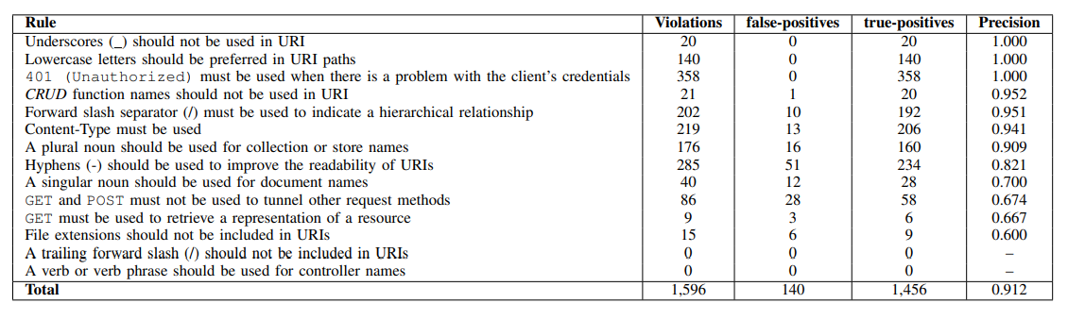
Effectiveness Results: Precision

Slide 18
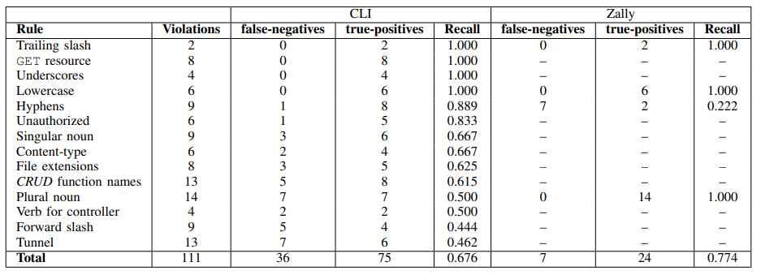
Effectiveness Results: Recall

Slide 19
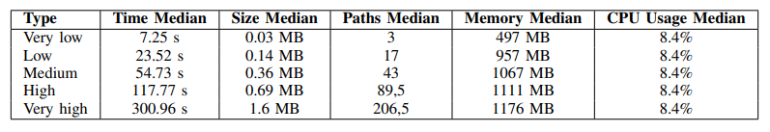
Performance Results

Slide 20
Conclusion & Outlook
Tool-support for analyzing an OpenAPI definition
Evaluation of the tool through an explorative study
Robustness: 98.03% success rate
Effectiveness: 67.6% recall; 91.2% precision
Performance: Time required to perform an analysis for most definitions ranges from 7 to 23 seconds; RAM requirements range from 497 MB to 957 MB.
The implemented rules from Massé are documented in GitHub for further development
Give us a star on GitHub
https://github.com/manuelmerkel/Projektarbeit-Master

